Slide 1
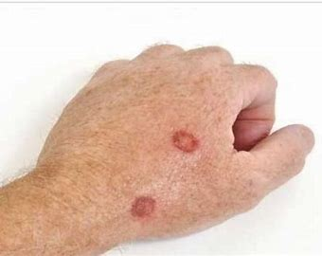
Skin cancer
Skin cancer detection

Slide 2
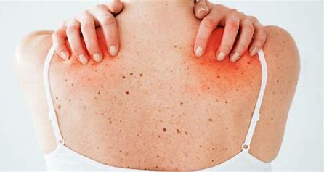
about disease
It’s called symptoms ,the abnormal growth of skin cells most often develops on skin exposed to the sun but this common form of cancer can also occur on areas of your skin not ordinarily exposed to sunlight.

Slide 3
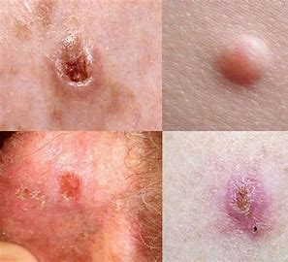
Skin cancer types
There are three major types of skin cancer:
Basal cell carcinoma.
Squamous cell carcinoma.
Melanoma.
you can reduce your risk of skin cancer by limiting or avoiding exposure to ultraviolet (UV) radiation.
Early detection of skin cancer gives you the greatest chance for successful skin cancer treatment.

Slide 4
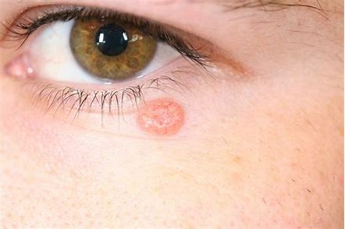
Basal cell carcinoma
Basal cell carcinoma begins in the basal cells a type of cell within the skin that produces new skin cells as old one die off.
Basal cell carcinoma often appears as a slightly transparent bump on the skin, though it can take other forms. Basal cell carcinoma occurs most often on areas of the skin that are exposed to the sun, such as your head and neck.

Slide 5
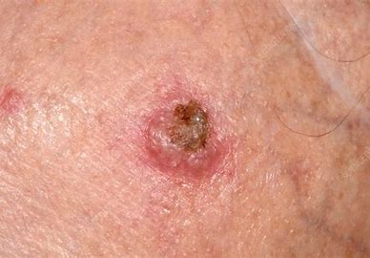
squamous cell carcinoma
Squamous cell carcinoma of the skin is a common form of skin cancer that develops in the squamous cells that make up the middle and outer layers of the skin.
Squamous cell carcinoma of the skin is usually not life-threatening, though it can be aggressive. Untreated, squamous cell carcinoma of the skin can grow large or spread to other parts of your body, causing serious complications.
Most squamous cell carcinomas of the skin result from prolonged exposure to ultraviolet (UV) radiation, either from sunlight or from tanning beds or lamps.

Slide 6
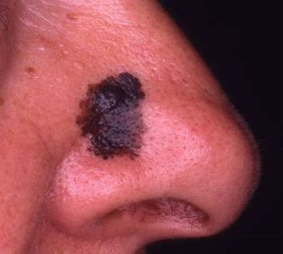
melanoma cell carcinoma
The most serious type of skin cancer , develops in the cells (melanocytes) that produce melanin the pigment that gives your skin its color.
Melanoma can also form in your eyes and ,rarely , inside your body ,such as in your nose or throat.

Slide 7
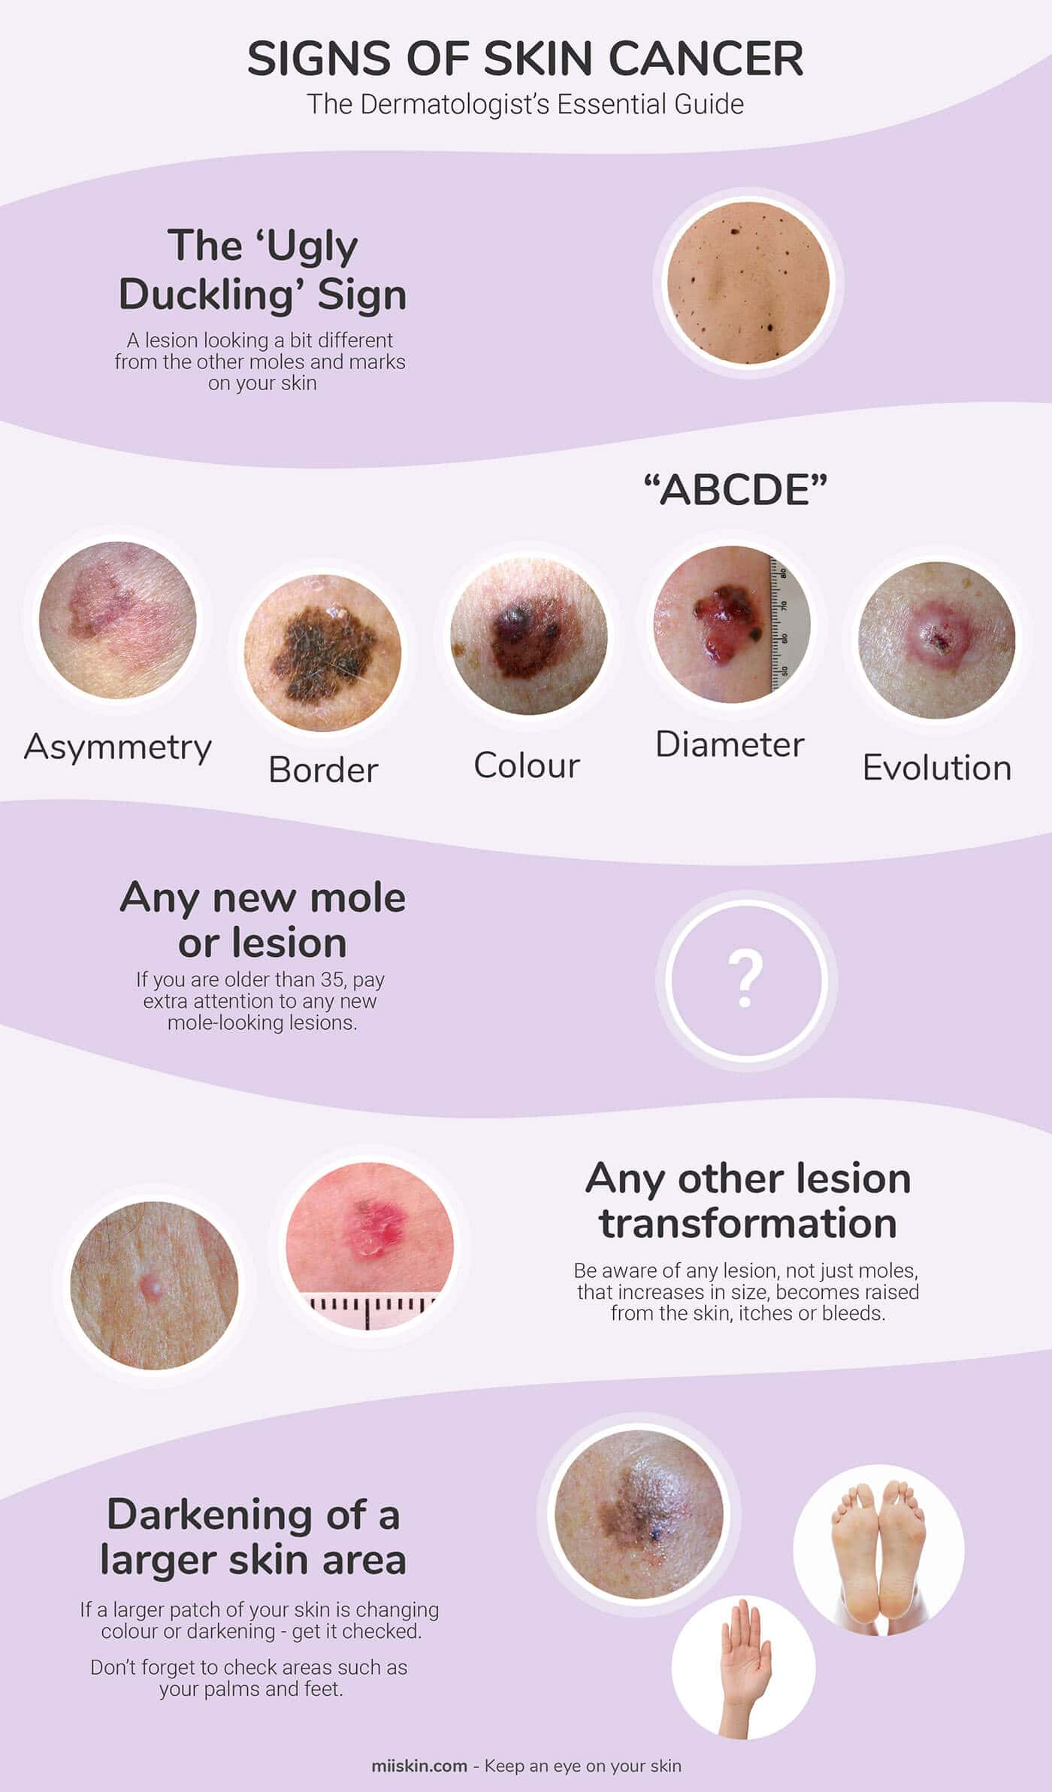
Our project
Problems
Solution
The most important problems of skin cancer is that the patient does not recognize the disease except in a late case which leads to difficulty in treatment.
although skin cancer appears on the skin in the early stages.
Early detection of skin cancer before it develops or reaches late stages.
By introducing images of the affected area and the application, the user will read and analyze them and find out the rate of skin cancer.

Slide 8

Comparison
Competitors
project provide high accuracy to detect skin cancer in its first stages ,that application will take picture of user skin and tell him percentage of his disease rate through the help of machine learning and Image processing.
National Cancer Institute. Skin Cancer. 2013. 16 March 2013.
Rockoff, Alan. Skin Cancer. 2013. 16 March 2013.
Drugs of Today 41.5 (2005): 37–53.
Swetter, Susan M. Cutaneous Melanoma. 2012. 16 March 2013.
Differences

Slide 9
References
References links
https://www.wowessays.com/free-samples/example-of-skin-cancer-research-paper/
https://www.wowessays.com/free-samples/example-of-skin-cancer-research-paper/
https://www.wowessays.com/free-samples/example-of-skin-cancer-research-paper/
https://www.wowessays.com/free-samples/skin-cancer-research-paper-examples/
https://www.mayoclinic.org/diseases-conditions/skin-cancer/symptoms-causes/syc-20377605
https://www.mayoclinic.org/diseases-conditions/skin-cancer/symptoms-causes/syc-20377605
https://ijcrt.org/papers/IJCRT2008296.pdf
https://www.wowessays.com/free-samples/example-of-skin-cancer-research-paper/

Slide 10



team
Menna Hassan shafik
Salma mamdouh sheta
Soha elsayed shaaban

Slide 11
Thank you!

